Slide 1


Slide 2
What is
DIZIMO / Christian Stewardship?

Slide 3
Stewardship/ DIZIMO is the dedication of our Time, Talents and Treasures in thanksgiving to God and in acknowledgement of all that He has given to us.

Slide 4
Where does the concept of Christian Stewardship come from?
From Sacred Scripture:
the Parable of the Talents
Matthew 25: 14 – 30
Each of us will be called to give an account of our stewardship.

Slide 5
There are 2 fundamental components to
Christian Stewardship

Slide 6


1. Stewardship of Time
and Talents

Slide 7


2. Stewardship of Treasure
(Financial Resources)

Slide 9
When each parishioner makes a Dedication of their Time and Talents, our parish becomes a Living, Vibrant, Faith-filled Community

Slide 10

The variety of Gifts given by the Spirit enables the Church to fulfill its divine mission of Evangelization

Slide 11
Christian Stewardship helps each parishioner to recognize and acknowledge a fundamental truth of our faith

Slide 12

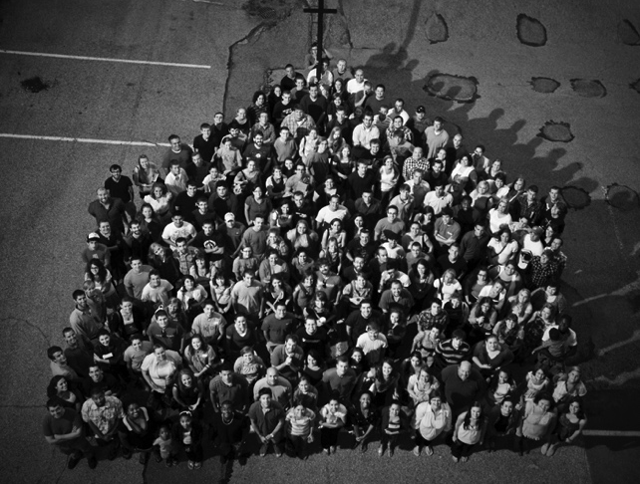
We are the Church!!

Slide 13
Stewardship enables us to express our joy in God’s abundant generosity towards us

Slide 14

STEWARDSHIP helps us to respond to God’s goodness and generosity:
Freely
Lovingly
Willingly

Slide 15

A shift in mindset is required
We become a Church that Provides
No longer a ‘provided for’ Church

Slide 16
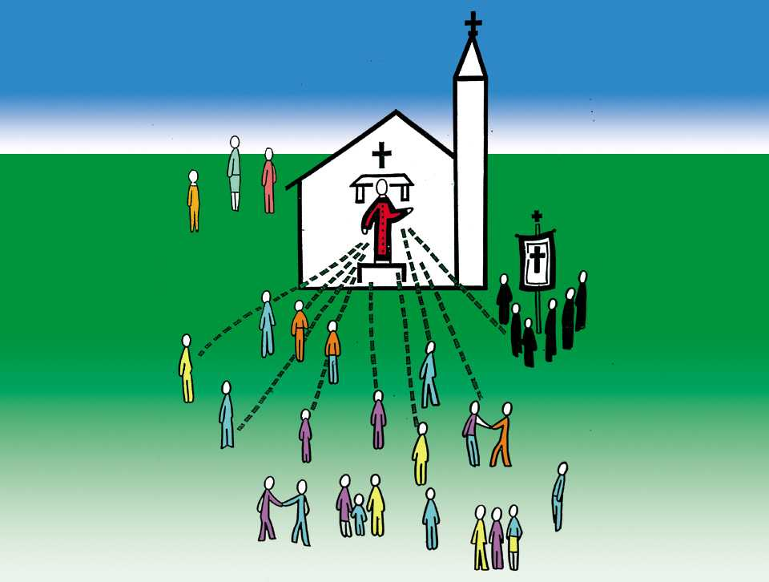
Our journey takes us from a priest-centered Church

Slide 17
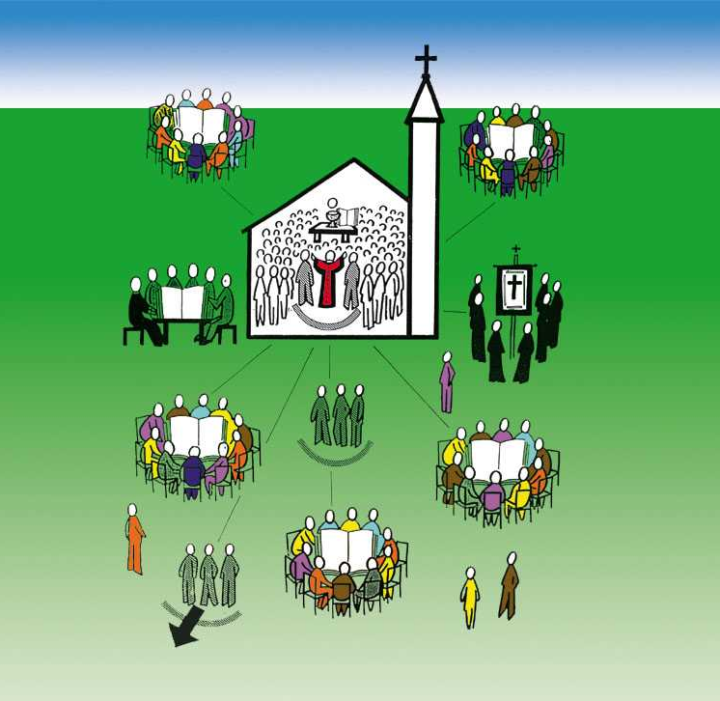
To a Church which is truly a Communion of Communities!!

Slide 18
Stewardship helps (and challenges) you to accept and assume your rightful ownership of and responsibility for the Church

Slide 19
Christian Stewardship ensures that the Parish’s needs are met, that the faithful are ministered to, and that each parishioner has an active participation and involvement in the life of the Parish

Slide 20
❖
We can do no great things, only little things with great love.
You can do what I can’t do.
I can do what you can’t do.
Together we can do something beautiful for God.
(St. Theresa of Calcutta)

Slide 21
Stewardship is doing something beautiful for God.

